Slide 1


SPOTIFY ANALYSIS USING TABLEAU
By : SHRIRAM M

Slide 2
Agenda
Objective
Reports
Key Findings
Recommendations
Assumptions

Slide 3
Objective
The objective of this project is to utilize Tableau's data visualization capabilities to analyze and present insights from Spotify data.
This project seeks to leverage Tableau’s visualization capabilities to transform raw Spotify data into meaningful and interactive visualizations that enable users to gain insights, make data-driven decisions, and explore their music preferences in a visually engaging manner.
As an analyst I have come up with recommendations on suggesting ways to stay competitive in music industry.

Slide 4
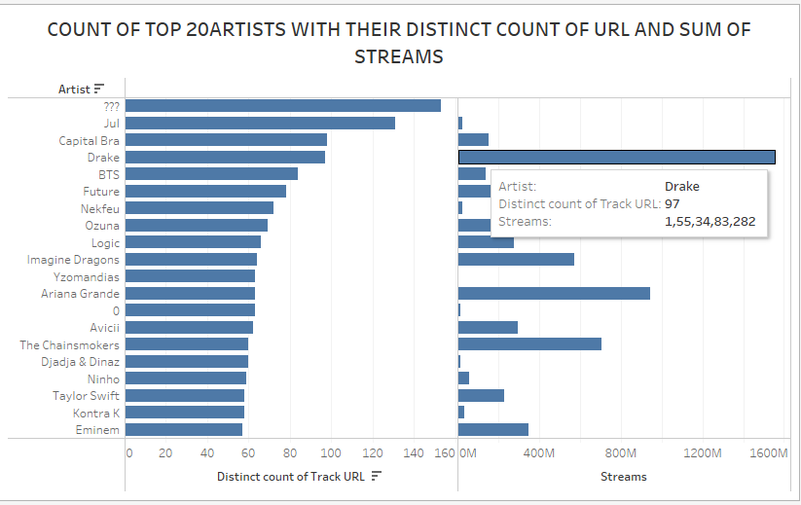
Top 20 artists with their distinct count of URL and their sum of streams

Slide 5
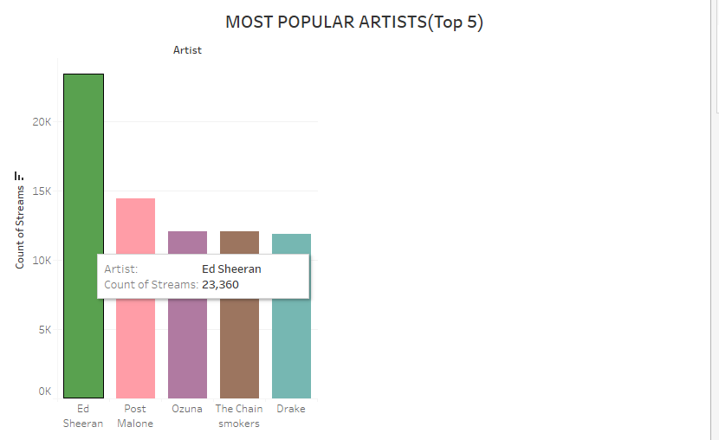
Top 5 Most Popular artists
Ed Sheeran is the most popular artist.

Slide 6
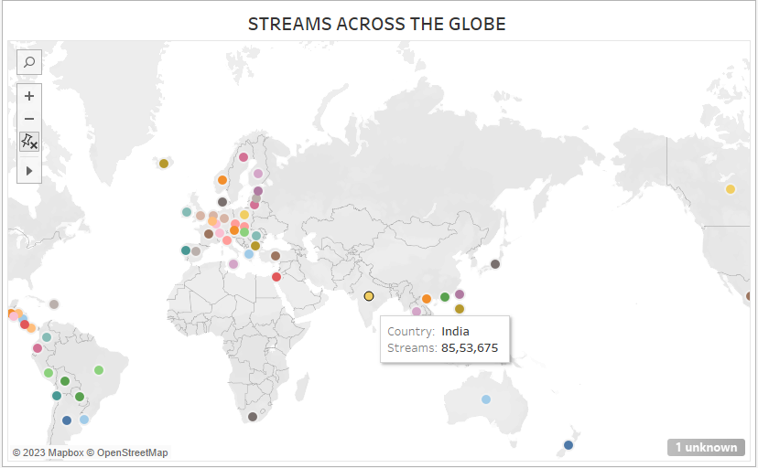
Map Chart(1)
Streams across the Globe

Slide 7
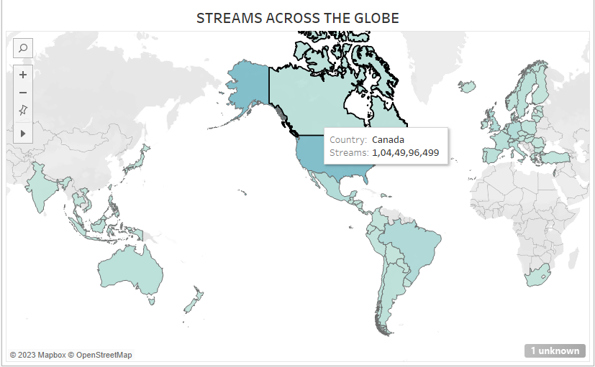
Map Chart(2)
Streams across the globe

Slide 8
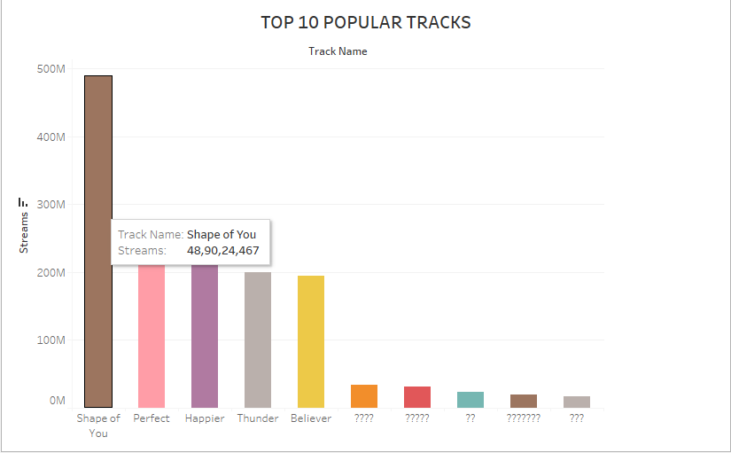
Top 10 Most Popular tracks
Shape of you is the most famous track

Slide 9
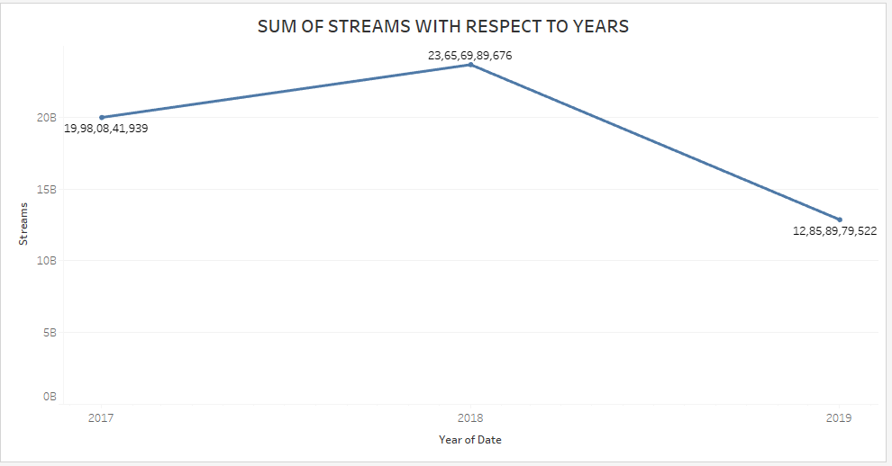
Sum of streams with respect to years
2018 is the year with highest amount of streams

Slide 10
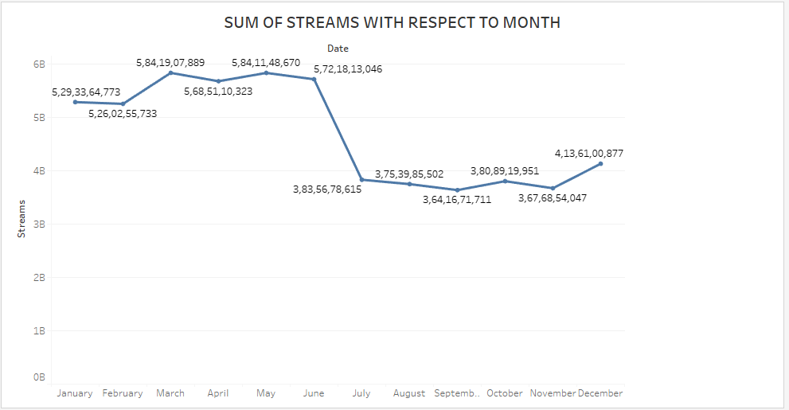
Sum of streams with respect to month
February month is the month with the highest sum of streams

Slide 11
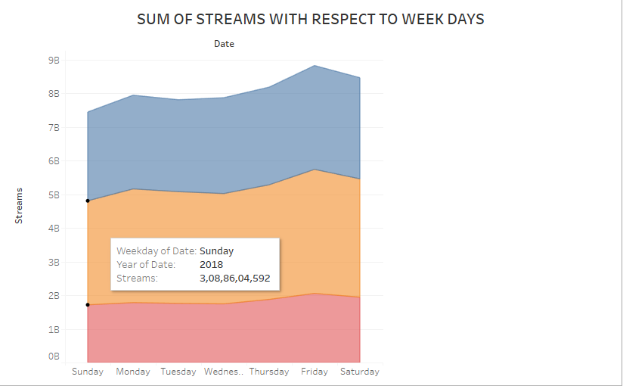
Sum of streams with respect to Weekdays
Friday is the day with the highest number of streams

Slide 12
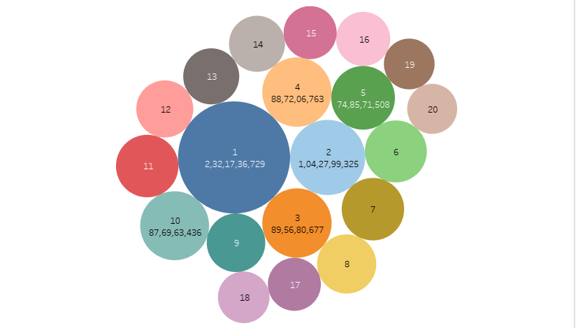
Position based on streams
Position 1 is with the highest number of streams

Slide 13
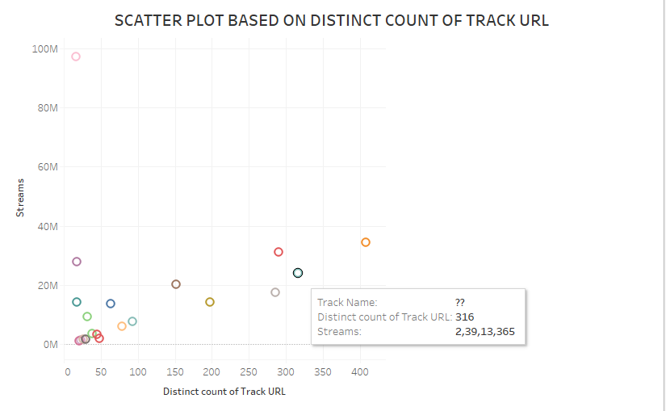
Scatter Plots
Scatter Plots based on distinct count of track URL

Slide 14
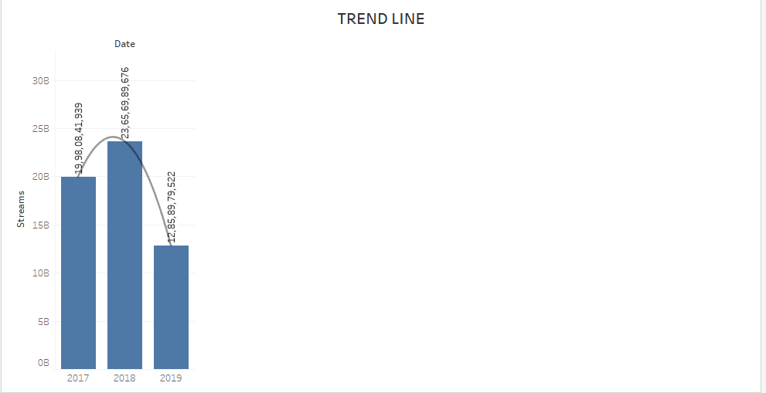
Trend Line
Polynomial Trend line shows the performance of spotify over the years

Slide 15
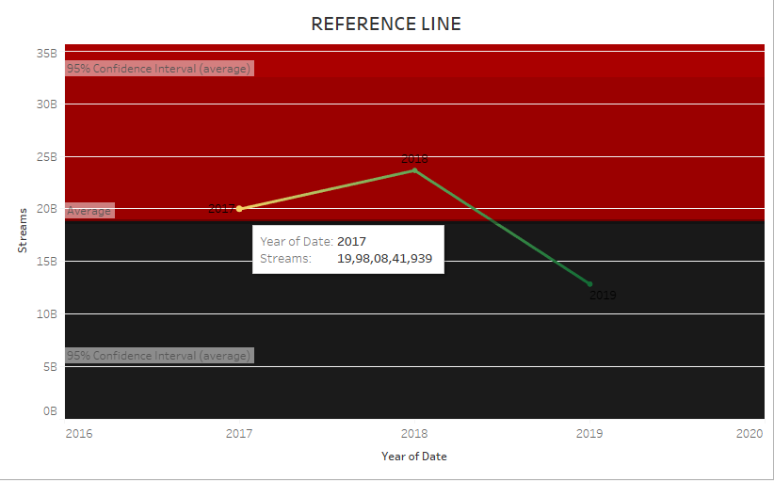
Reference line
Reference line diagram with 95% confidence interval by taking the average streams

Slide 16
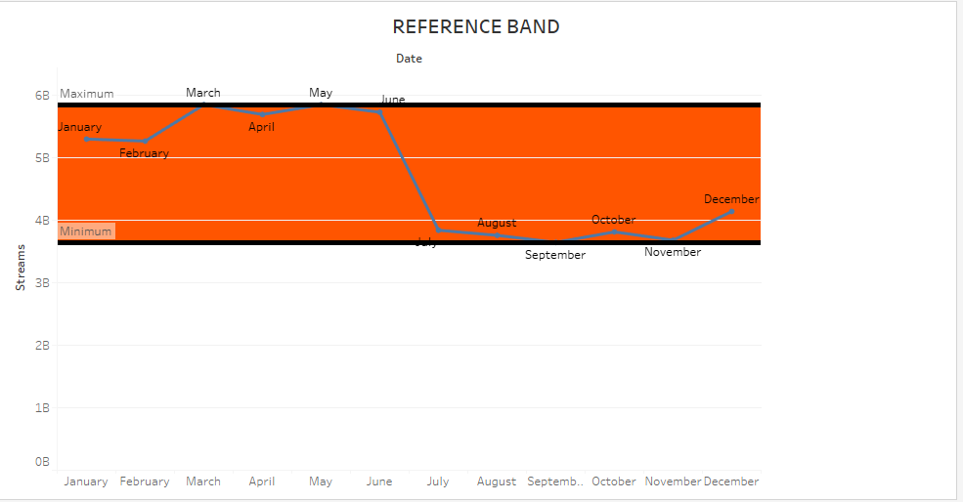
Reference band
Reference band diagram shows the maximum and minimum sum of streams

Slide 17
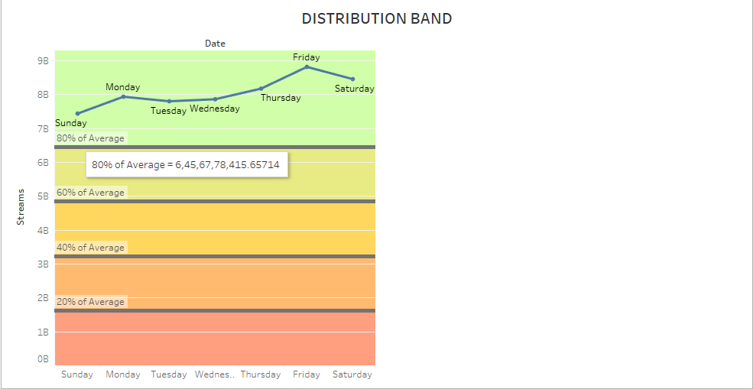
Distribution band
This is a distribution band that shows averages of streams ranging from 80% average,60% average,40% average and 20% average

Slide 18
Reports
The total number of tracks are 10,48,575.
The count of distinct tracks are 24,988.
The total number of artists are 7,912.
The sum of streams is 56,49,68,11,137.
The distinct count of track URL is 33,601.

Slide 19
Key Findings
As per the trend line analysis 2018 has seen huge rise in the number of streams.
Most of the songs have got released in the year 2017 which in turn would have taken time to become viral and spread globally .
As a result, lot of songs have been repeatedly played even in the year 2018 and 2019.
Songs like Shape of you and Perfect are people’s favourites.
Global is the country with the highest number of streams followed by United States of America.
March month is the month with the highest number of streams.
Fridays are music listener's favourite day as most of the songs are played on that day.

Slide 20
Recommendations
A global brand ambassador can be selected to promote the brand globally.
The premium package can be given with a slight amount of discount to newly logged users.
Spotify can target the Indian Audience as Indians love regional music and International Music.
Spotify can stream podcasts apart from just songs.
A chartbuster rankings can be given to top 20 trending songs of the week or the month i.e rankings based on people’s likings.
Social Media pages can be created to globalize the songs.
Minimum advertisements or promotions can be displayed as it somehow attracts people to market their brand and ,also it indirectly aids to the revenue of Spotify.
Music preferences can be given as suggestions based on user’s likings.
Just like amazon’s watch party Spotify can also take measures where three or four friends can join together and hear songs.

Slide 21
Assumptions
The data set did have a lot of blanks.
2.So a null value(0) has been assigned to blank spaces.
3. A few areas the artist’s name and track names have begun with ?. Since it is a non-numerical data, I haven’t changed it .

Slide 22
Thank You.

